Slide 2
What is Hadoop Cluster
Learn Architecture of Hadoop Cluster
Learn data storage in hdfs
HDFS Architecture
HDFS Hadoop Features

Slide 3
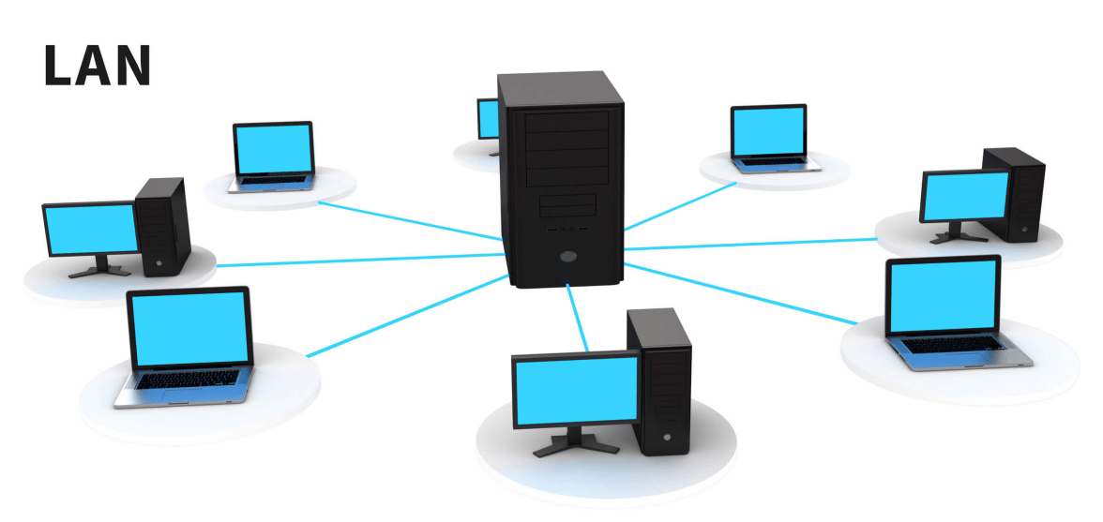
What is Hadoop Cluster?

Slide 4
What is Hadoop Cluster?
Storing and processing large data sets
Commodity hardware connected together.
Communicate with a high-end machine.
Master and slaves implement distributed computing

Slide 5
Architecture of Hadoop
Master Node
Master/Slave Architecture
NameNode
Resource Manager
Slave Node
Slave Node
Slave Node
Slave Node
DataNode
DataNode
DataNode
DataNode
Node Manager
Node Manager
Node Manager
Node Manager
Map
Reduce
Map
Reduce
Map
Reduce
Map
Reduce

Slide 6
Architecture of Hadoop
Master in Hadoop Cluster
There are two daemons running on the master and they are
NameNode
Resource Manager

Slide 7
Architecture of Hadoop
Functions of NameNode
  Manages file system namespace
  Regulates access to files by clients

Slide 8
Architecture of Hadoop
Functions of NameNode
  Stores metadata of actual data Foe example – file path, number of blocks, block id, the location of blocks etc.

Slide 9
Architecture of Hadoop
Functions of NameNode
  Executes file system namespace operations like opening, closing, renaming files and directories

Slide 10
Architecture of Hadoop
Functions of NameNode
  The NameNode stores the metadata in the memory for fast retrieval. Hence we should configure it on a high-end machine.

Slide 11
Architecture of Hadoop
Functions of NameNode
DataNode
DataNode
block
block
block
block
NameNode
DataNode
DataNode
block
block

Slide 12
Architecture of Hadoop
Functions of Resource Manager
Node Manager
Node Manager
container
container
container
container
Resource Manager
Node Manager
Node Manager
container
container

Slide 13
Architecture of Hadoop
Slaves in the Hadoop Cluster
There are two daemons running on Slave machines and they are –
DataNode
Node Manager

Slide 14
Architecture of Hadoop
Functions of a Data Node
It stores the business data
It does read, write and data processing operations
Upon instruction from a master, it does creation, deletion, and replication of data blocks.

Slide 15
Architecture of Hadoop
Functions of a Node Manager
It runs services on the node to check its health.
Scale Hadoop cluster

Slide 16
Architecture of Hadoop
Client nodes in Hadoop cluster – We install Hadoop and configure it on client nodes.

Slide 17
Architecture of Hadoop
Functions of the client node
  To load the data on the Hadoop cluster.
  Tells how to process the data by submitting MapReduce job.
  Collects the output from a specified location.

Slide 18
Data Storage in HDFS

Slide 19
Example
Hadoop Cluster

Slide 20
Example
100TB File
Hadoop Cluster

Slide 21
Example
100TB File
Block
Block
Block
Block
.
.
.
.
Hadoop Cluster

Slide 22
Example
When client copy this data in Hadoop
100TB File
Block
Block
Block
Block
.
.
.
.
Hadoop Cluster

Slide 23
Example
When client copy this data in Hadoop
100TB File
Block
Master
Block
Block
Block
.
.
.
.
Hadoop Cluster

Slide 24
Example
When client copy this data in Hadoop
100TB File
Block
. . . .
Master
Block
. . . .
Block
Block
. . . .
.
.
.
.
. . . .
Slaves
Hadoop Cluster

Slide 25

What is Hadoop High Availability?
Single Point of Failure

Slide 26
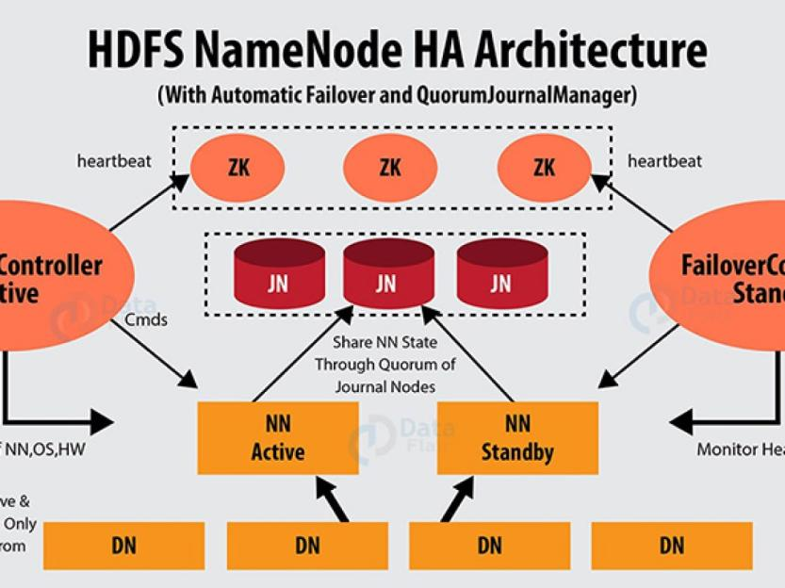
What is Hadoop High Availability?
(Passive Standby Name Node) for automatic failover

Slide 27
What is Hadoop High Availability?
What is Failover?
Failover is a process in which the system transfers control to a secondary system in an event of failure.
Graceful Failover
Automatic Failover
There are two types of failover

Slide 28
HDFS Architecture

Slide 29
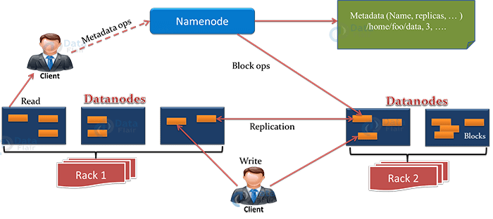
HDFS Architecture

Slide 30
Hadoop HDFS Features
Distributed Storage
Blocks
Replication
High Availability
Data Reliability
Fault Tolerance
Scalability
Vertical Scaling
Horizontal Scaling
High throughput access to application data

Slide 31
Hadoop HDFS Features
Distributed Storage
Blocks
Replication
High Availability
Data Reliability
Fault Tolerance
Scalability
Vertical Scaling
Horizontal Scaling
High throughput access to application data

Slide 32
Hadoop HDFS Features
Distributed Storage
Blocks
Replication
High Availability
Data Reliability
Fault Tolerance
Scalability
Vertical Scaling
Horizontal Scaling
High throughput access to application data

Slide 33
Hadoop HDFS Features
Distributed Storage
Blocks
Replication
High Availability
Data Reliability
Fault Tolerance
Scalability
Vertical Scaling
Horizontal Scaling
High throughput access to application data

Slide 34
Hadoop HDFS Features
Distributed Storage
Blocks
Replication
High Availability
Data Reliability
Fault Tolerance
Scalability
Vertical Scaling
Horizontal Scaling
High throughput access to application data

Slide 35
Hadoop HDFS Features
Distributed Storage
Blocks
Replication
High Availability
Data Reliability
Fault Tolerance
Scalability
Vertical Scaling
Horizontal Scaling
High throughput access to application data

Slide 36
Hadoop HDFS Features
Distributed Storage
Blocks
Replication
High Availability
Data Reliability
Fault Tolerance
Scalability
Vertical Scaling
Horizontal Scaling
High throughput access to application data

Slide 37
Hadoop HDFS Features
Distributed Storage
Blocks
Replication
High Availability
Data Reliability
Fault Tolerance
Scalability
Vertical Scaling
Horizontal Scaling
High throughput access to application data

